Slide 1

Sector document production of and wholesale of vegetable seeds
Collaboration AMLC and Customs
May 2023
    Introduction
The Anti-Money Laundering Centre (AMLC) and Dutch Customs started a collaboration on 1 January 2023 in which four sectors were jointly investigated in the context of Trade-Based Money Laundering (TBML).
The production and wholesale of vegetable seeds were investigated first. An investigation into AMLC data, Customs data and open source information yielded many insights. To really get to know the sector, a themed day was organised for the sector, the sector association and regulators.
In this way, joint interpretation is given to the concept of Know Your Sector, which maps out how goods and money flows run and what sector-specific practices are. This knowledge can be used to look for deviations in both the flow of goods and money, signals can be better interpreted and any barriers that can be erected to make the sector more resilient to abuse can be examined.
The purpose of this document is to share the knowledge gained with analysts, investigations, regulators and other interested parties.
    The sector of production and wholesale of vegetable seeds in the Netherlands
    According to the explanation of the Central Bureau of Statistics, the sector of “production and wholesale of seeds” consists of different SBI codes (Standard Business Classification); production is not the same as wholesale. However, the most well-known enterprises in this sector are engaged in both production and trading. They most often classify themselves under SBI code 46212: “Wholesale in seeds, seed potatoes and legumes”. Please note, the classification does not include the wholesale of flower bulbs.
    It is important to know that the Netherlands has a leading role in this sector worldwide. It is a very innovative sector that, in addition to seed trading, is also involved in seed propagation and seed technology. More information can be found on the website of Plantum, the trade association for the seed and young plants sector: www.plantum.nl.
    Companies in the sector are certainly competitors, but they also often work together. Another characteristic is that companies in the sector are often located close to each other in regional centres. A well-known partnership is the North Holland is ‘Seed Valley’ (www.seedvalley.nl). But there are also many companies located in the Westland, North Brabant and around Venlo.
    Innovation, rights and supervision in the sector
      Development of varieties
Developing new varieties takes a lot of time and money.
Breeders invest up to 15% of their turnover in this development. One form of intellectual property, plant breeder’s rights, gives companies the exclusive right to propagate and sell a new variety for a certain period of time. The breeder’s exemption ensures other breeders are allowed to use this protected crop for further development and to develop new varieties.
Plant breeder’s rights
Biodiversity and genetic resources are the basic material for plant breeding. It is very important for the constant improvement of varieties to have access to all genetic resources, including commercial plant material. There are various agreements, laid down in several international treaties, to distribute the rules for the use of genetic biodiversity in a proper and fair manner (including the Nagoya protocol and the International Treaty on Plant Genetic Resources for Food and Agriculture).

Slide 2
Plant breeder’s rights (continued)
It is also possible to apply for a patent on a new plant property when a technical step has been used for the innovation. There are concerns within the sector about this, partly because varieties with a patented characteristic are no longer freely used by other breeders for further improvement and breeding.
Innovation in plant breeding is badly needed. Discussions are now being held in Europe about the admission of new techniques in plant breeding. With these new techniques, more targeted work will be done on, for example, resistance to diseases and the consequences of climate change.
    Quality requirements
Young plants and seeds are transported all over the world and every country has its own regulations when it comes to exporting and importing products. Europe is increasingly exposed to phytosanitary risks due to increasing trade flows and climate change. Thanks to its continuous product innovation, development of new varieties and high quality of seeds and young plants, as well as good logistics, the Netherlands has a strong export position. Market access to third countries is very important for the marketing of the products.
    Supervision
    The more specific supervision of the sector of production and wholesale of seeds lies with the Netherlands Food and Consumer Product Safety Authority (www.nvwa.nl), Naktuinbouw (www.naktuinbouw.nl) and NAK (www.nak.nl). In summary, the NVWA monitors the health of seeds and plants, while Naktuinbouw and NAK stand for the quality of seeds and plant material (vegetable starting material).
    Pursuant to EU Regulation 2019/2072, a phytosanitary certificate is mandatory when importing plants and plant products. Sometimes, it is also mandatory to have imported shipments inspected by the NVWA. A certificate and inspection are mandatory for a number of seed types in combination with the country of origin (e.g. mustard seed, onion seed, paprika seed, tomato seed). The NVWA is responsible for checking the presence/correctness of a phytosanitary certificate and inspecting the goods upon import. When encountering seeds at the border in passing, Customs calls in inspectors from the NVWA.
      Import and export of vegetable seeds in
      the Netherlands
Commodity Name List International Trade
      The Commodity Code Lists are named by Eurostat in the Combined Nomenclature (CN). This Combined Nomenclature contains the classification of goods prescribed by the European Union for the statistics of the International Trade in Goods. The GN has an 8-digit format.
      The annual changes result from adjustments that are necessary for both Customs and statistics.
      Commodity code 12099180 is used for vegetable seed, sowing seed (with the exception of red beet seed).
      Customs value of seeds
      One generic commodity code is therefore often used for seeds. This makes differentiation between seed types and the calculation of the average customs value per type difficult.
      It is known that the production method influences the value of seeds. Does a greenhouse where a lot of innovation has been applied run limited production batches or are the seeds coming directly from the plant, i.e. hybrid seed (expensive) versus open pollinated seed (cheaper). Plant breeder’s right also affects the value.
      As an indication, based on the import data from 2021 and 2022, Customs has calculated that the average declared value per shipment of vegetable seeds upon import was approximately € 37,000. In the same way, based on the export data from 2021 and 2022, it was calculated that the average declared value per shipment of vegetable seeds was € 52,000 upon export.
      Weight
      The weight of vegetable seed shipments does not say much about the value of the shipment. This is partly because the weight depends on the type of seed. For example, legume seeds are much larger and heavier than tomato seeds. In addition, seeds intended for open ground (sowing seed), such as seeds for carrots, spinach and various types of cabbage, generally have a lower value than seeds intended for greenhouse cultivation, such as cucumber, pepper and tomato seeds. The weight of a shipment of vegetable seeds ultimately says little about the possible value of this shipment.

Slide 3
    Obligation to report unusual transactions
    Under the Money Laundering and Terrorist Financing (Prevention) Act (Wwft), buyers and sellers of goods are obliged to report unusual transactions. These reports are made to FIU-Nederland.
Producers of - and the international wholesale of vegetable seeds fall under the reporting group ‘Buyers and sellers of goods’. For more information, please visit the website of FIU Nederland (www.fiu.nl).
After an investigation, the FIU can declare a reported unusual transaction suspicious. This is what is referred to as a suspicious transaction. Suspicious transactions are further investigated by the AMLC, among others, in the context of its duties.
    What makes the sector vulnerable?
    The value of vegetable seeds is difficult to determine because of the wide variation in price and quality. Some seeds cost more per kilo than a kilo of gold. However, other seeds cost no more than a few cents;
    Waste and/or loss of A-quality vegetable seeds is still traded as A-quality, despite the lower quality;
    A-quality vegetable seeds are cloned and offered at a lower price;
    Vegetable seeds with a high value per kg can be moved easily;
    B-quality vegetable seeds are repackaged and sold as A-quality vegetable seeds;
    What makes the sector resilient?
    Production companies and wholesalers of vegetable seeds work with regular customers;
    The vegetable seed sector is relatively small, ‘like knows like’
1
2
3
      Outcomes investigation of suspicious transactions
The investigation examined some 165 suspicious transactions related to the seed technology industry and seed wholesale in general. The following stands out:
In almost all cases the suspicious transactions relate to export;
Most suspicious transactions are reported by banks. The other suspicious transactions are reported by accountants and Payment Service Providers (PSPs);
The vast majority concerns transfers to bank accounts of Dutch suppliers involved
These transfers largely originate from the Baltic States;
The most common reason for reporting is laundromats;
Sanctions against Iran and Russia were also mentioned as the reason for the reports, whether or not in combination with a laundromat. Affected suppliers try to retain customers from the period before the sanctions were introduced and still accept payment through an unusual channel.
4
5
1
2

Slide 4
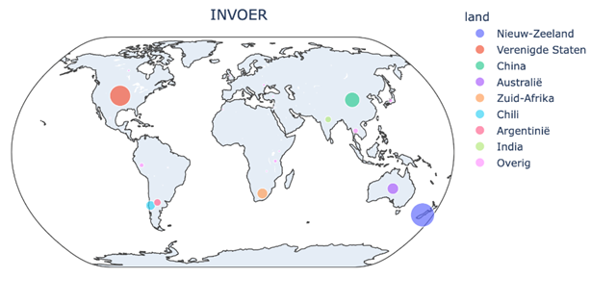
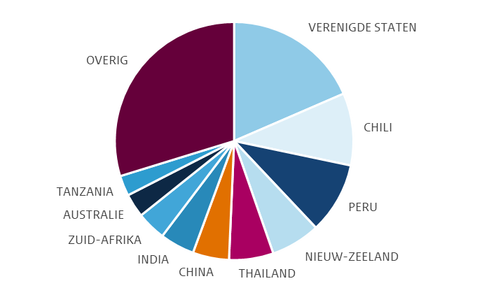
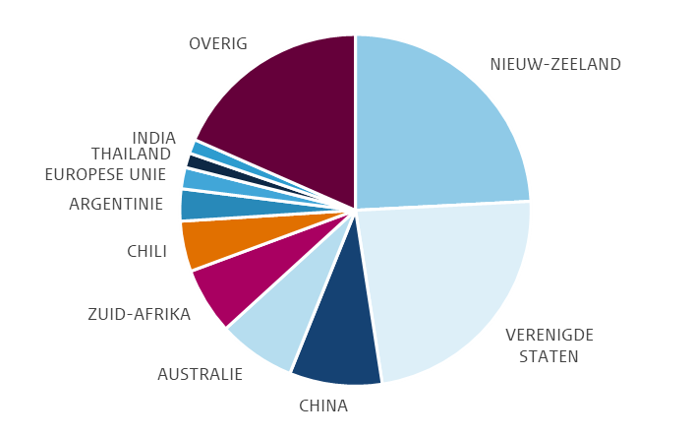
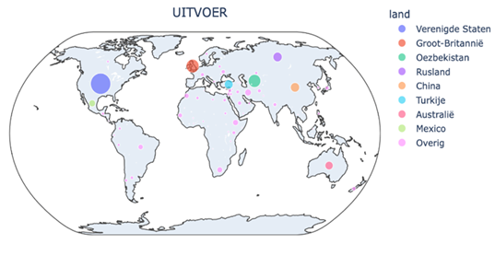
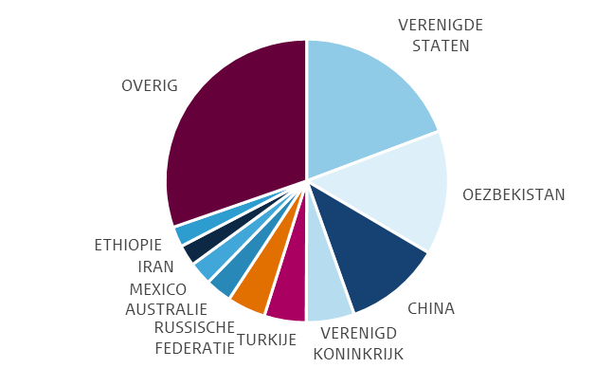
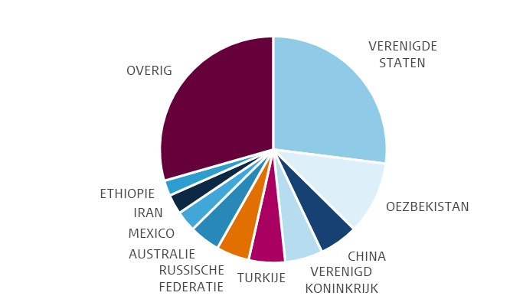
Import and export of seeds in the Netherlands (continued)
    Import 2021-2022
              During this period, vegetable seeds worth €663 million were imported via the Netherlands (€304 million in 2021 and €359 million in 2022).
              The average declared value per shipment of vegetable seeds upon import is €37,000.
              Import prices vary from €0.01 to €660.00 per kg
              Breeding and selection companies account for 85-90% of the total declared value of vegetable seeds upon import.
              During this period, a net total of 8.7 million kilogrammes of vegetable seeds was imported (4.5 million kilogrammes in 2021 and 4.2 million kilogrammes in 2022).
Distribution by imports in value by country 2021-2022
Distribution by imports in weight by country 2021-2022
    Export 2021-2022
              During this period, € 2.6 billion worth of vegetable seeds were exported via the Netherlands (€1.3 billion in both 2021 and 2022).
              The average declared value per shipment of vegetable seeds upon export is €52,000.
              Export prices vary from €0.001 to several million euros per kg.
              Breeding and selection companies account for nearly 95% of the total declared value of vegetable seeds upon export.
              During this period, a net total of 16.6 million kilogrammes of vegetable seeds was exported (7.3 million kilogrammes in 2021 and 9.3 million kilogrammes in 2022).
Distribution by exports in value by country 2021-2022
Distribution by exports in weight by country 2021-2022

Slide 5

Import and export of vegetable seeds in the Netherlands (continued)
Production cycle of vegetable seeds and place of supervision
The diagram below shows the production cycle of vegetable seeds. You can see that production is usually outsourced to countries outside the European Union. In 80% of cases, production is handled by third parties and in 20% by subsidiaries of the seed breeders. It then returns to be prepared for sale (also known as cleaning or coating) after which the product is traded intra-Community within the EU or exported.
Customs and the NVWA act on behalf of the EU when vegetable seeds cross the external border of the EU.
    What is trade-based money laundering?
TBML is the use or setting up of international trade structures to launder money. These are not one-off transactions, but professional money launderers who launder millions through well-organised constructions. According to the FATF, to confirm TBML, the following conditions must in any case be met:
There must be criminal profits/value;
There must be an intent to move this value through products being traded;
This movement must result in legitimacy. The criminal money must be given an apparently white status.
Many manifestations of TBML involve a form of document fraud;
Over and under-invoicing
Transshipment and under-shipment
Phantom shipping (i.e. nothing is shipped but invoicing does take place)
Multiple invoicing
Incorrect description of goods/services
In recent years, however, a less complex form of TBML without document fraud has also been observed in the Netherlands, in which goods are purchased in the right quantity and quality using money earned in criminal ways, for a market price. These goods are then exported and sold again. For more information, see the AMLC website.
Colophon
This sector document has been carefully prepared by the AMLC and Customs. If you have any questions and/or comments, please contact us at aml.centre_postbus@belastingdienst.nl
© AMLC Version May 2023

